Slide 1

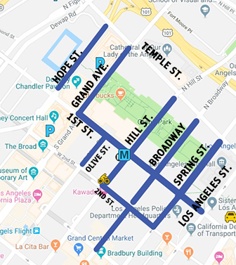



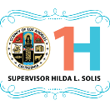

GRAND PARK + THE MUSIC CENTER 4TH OF JULY BLOCK PARTY 2019 What is Grand Park? Grand Park, with its majestic views extending from The Music Center to City Hall, provides Angelenos of all walks of life a place where they can come together to celebrate, reflect and shape the future, in one central gathering place. Located in Downtown L.A.’s Bunker Hill neighborhood and activated 52 weeks a year by The Music Center with free events for all, Grand Park has become a hub for both large and small scale performances, celebrations and other activities. The park also hosts film shoots, photo shoots, and lease events. What is Grand Park + The Music Center’s 4th of July Block Party? A free family friendly event, Grand Park + The Music Center’s 4th of July Block party invites all residents of L.A. County to celebrate the nation’s independence on THURSDAY, JULY 4, 2019 with live music, food vendors, a new addition of a Ferris wheel, culminating in a beautiful fireworks display. Event Details: Celebrating its seventh year, Grand Park + The Music Center are expecting approximately 35,000 attendees and are working with all relevant agencies to ensure this community gathering is safe with minimal street closures. Streets will begin closing in the evening of WED JULY 3, and reopening early morning FRI JULY 5. Event begins at 3PM with the fireworks display at 9PM, and the event ends at 9:30PM. Grand Park is working with all relevant agencies to ensure street closures are kept to the minimum possible. STREET CLOSURES AND TIMES:
4TH OF JULY
BLOCK PARTY
2019
COLOR LEGEND | Closure / Outside Event Perimeter | Closure / Inside Event perimeter
STREETS | Wednesday July 3, 2019 | Thursday July 4, 2019 | Friday July 5, 2019
HOPE ST (btw TEMPLE/1ST) | 5AM-12PM: NORTH BOUND LANE CLOSURE for LOAD IN | 7:30PM - 10:00PM Partial closure (FIREWORKS FALLOUT ZONE) | 5AM-12PM: NORTH BOUND LANE CLOSURE for LOAD OUT
GRAND AVE (btw TEMPLE/1ST) | open | 7:30PM - 10:00 PM Partial closure (FIREWORKS FALLOUT ZONE) | open
HILL ST (btw TEMPLE/2ND) | 7PM: full closure | full closure continues | 6AM: all lanes open
BROADWAY (btw TEMPLE/2ND) | 7PM: full closure | full closure continues | 6AM: all lanes open
BROADWAY (btw 2ND/3RD ST) | open | 12:00am All day full closure | 3AM: all lanes open
SPRING ST (btw TEMPLE/1ST) | 8AM: full closure | full closure continues | 6AM: all lanes open
SPRING ST (btw 1ST/2ND) | 7PM: full closure | full closure continues | 6AM: all lanes open
OLIVE ST (btw 1ST/2ND) | open | 12:00am All day full closure | 3AM: all lanes open
1ST ST (btw GRAND / LOS ANGELES) | 7PM: full closure | full closure continues | 6AM: all lanes open
2ND ST (btw HILL/SPRING) | open | 12:00am All day full closure | 3AM: all lanes open
Grand Park’s address is
200 N. Grand Ave Los Angeles, 90012
FOR MORE INFO / PARA MÁS INFORMACIÓN grandparkla.org/4thofjuly
Grand Park is an L.A. County park powered by The Music Center

